Slide 1
Image Caption Generation
By
Ashley H. Chu, Zhiyuan Chen, Alexander Galvan, Yunyao Wu,Zixuan Zhao
Notes:
This PowerPoint Template includes a series of slide masters with predefined layouts and color schemes for formatting slides
Slide Masters are displayed when you right click on a slide and select Layout from menu

Slide 2
Discussion
Background and Related Work
Datasets
Flickr
GCC
Methodology
Base Component
Experimental Structure
Evaluation
Conclusion

Slide 3
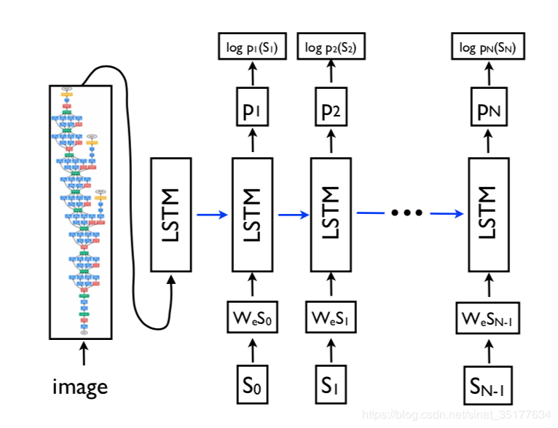
Background and Related Works
Show Attend and Tell
Generate Natural Language based from CNN and LSTM
CNN
Image Inputted
Extract Features
LSTM
CNN Featues Inputted
Generate Corresponding Description
Model used throughout Show and Tell

Slide 4
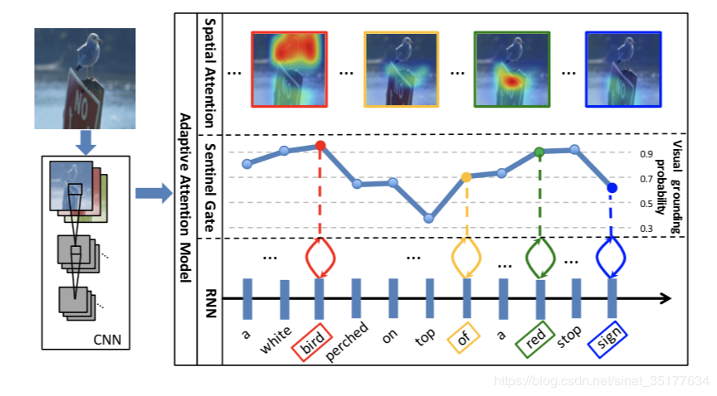
Background and Related Works
Knowing When To Look
Proposes Sentinel Mechanism
Model Calculates Word and Image Relatance
Determine Overall Sentence
“bird” and “red” given High Importance
Determining Important Words from an Image

Slide 5
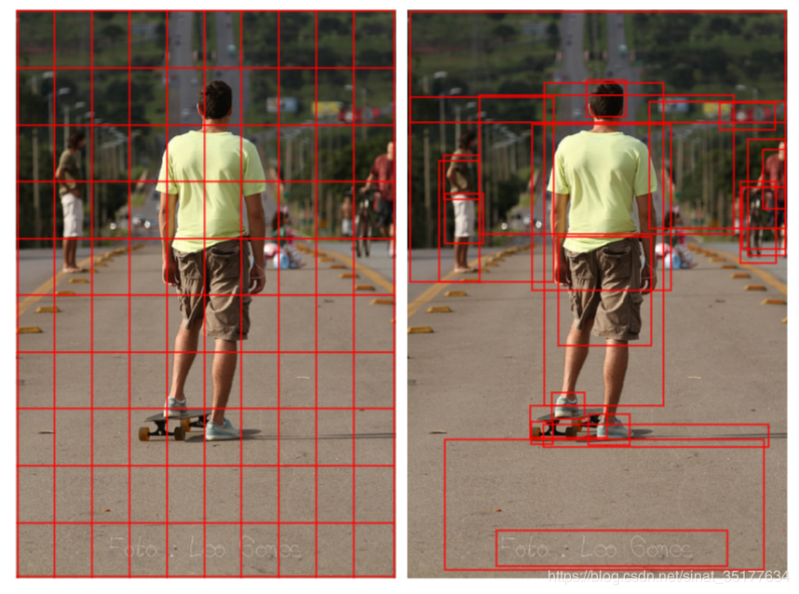
Background and Related Works
Bottom-Up and Top-Down Attention for Image Captioning and Visual Question Answering
Object Detection based on Theory:
Humans describe Images based from Neighboring Objects
Images divided into k Target Areas
Determine Importance of Objects
Usually based from Image Size
Generate Image Description
Dividing given Image into Separate Areas

Slide 6
Datasets
Datasets | What | Why | Our project | Data source
Flickr8k | •8,091 images •5 captions for each image •6k for training •1k for testing •1k for development | •Small size in data •Properly labelled •The dataset is free | •8k images •3 captions for each image (24k) | Flick8k
Google’s Conceptual Captions (GCC) | •>3.3M pairs •3,318,333 for training •15,840 for validation •12,559 (hidden) for testing | •Larger data •Wider variety of styles •Data are from web pages | •24k pairs randomly •1 caption for each image | GCC

Slide 7
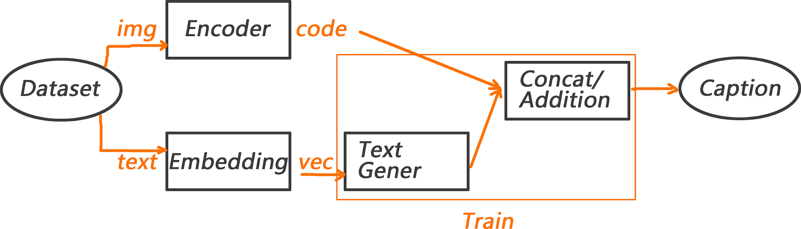
Methodology
2 Datasets
3 Img Encoders
4 Text Generators
3 Batchsizes
Flickr8k(24k pairs)
Conceptual Caption
InceptionV3
Resnet 50
VGG16
Bi LSTM +Addition
LSTM +Concat
Bi LSTM +Concat
2 LSTM +Concat
1024(<0.5h/model)
512 (1h/model)
128 (7h/model)
x
x
x

Slide 8
Methodology
2 Datasets
3 Img Encoders
4 Text Generators
3 Batchsizes
Flickr8k(24k pairs)
Conceptual Caption
InceptionV3
Resnet 50
VGG16
Bi LSTM +Addition
LSTM +Concat
Bi LSTM +Concat
2 LSTM +Concat
1024(<0.5h/model)
512 (1h/model)
128 (7h/model)
x
x
x
Scaled down to 24k pairs
100 times longer
Performs
no better

Slide 9
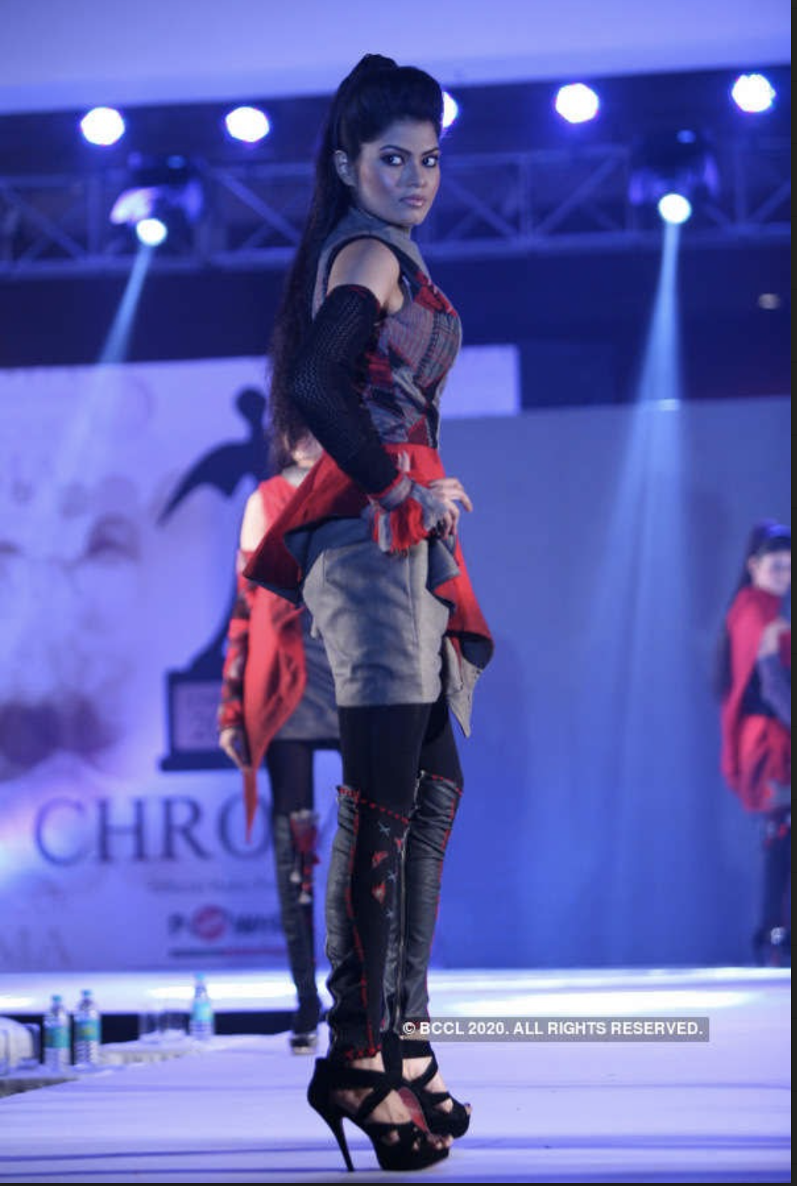

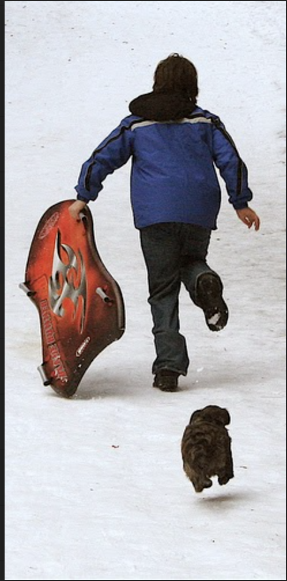
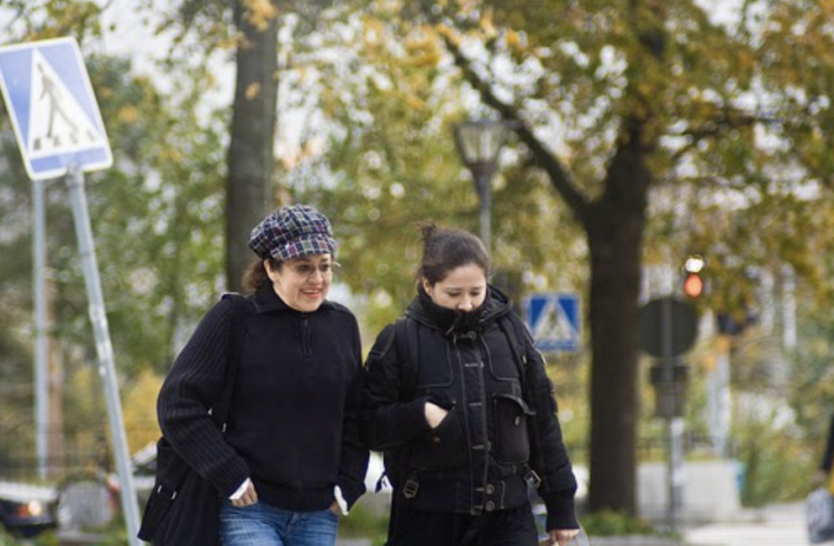
Quantitative Results
Conceptual training
Flickr training
Bi-LSTM
Inception V3 a person standing a woman shows man in blue shirt is standing man in the water is jumping
a fast number of the water on the sidewalk on the water
ResNet50 person artist performs portrait of a woman girl man in blue shirt is playing woman in sunglasses is standing
during stage during festival holding her hair in the snow in front of building
2LSTM
Inception V3 a person love the heart of the rain person in blue shirt is standing in the water man in black jacket
ResNet50 a artist of a white background actor of a portrait of a girl two children are playing in the snow woman in black jacket is
walking down the street
hallucination

Slide 10
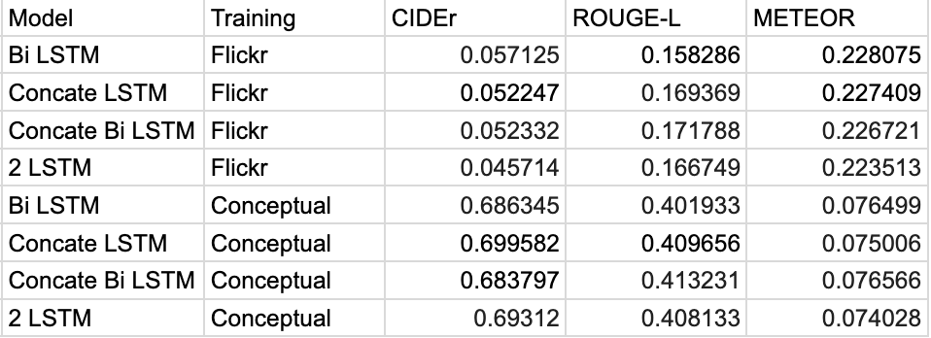
Quantitative Results
Metrics
CIDEr
ROUGE-L
METEOR
Automatic evaluation results
Conceptual trained models are better than the Flickr trained models
ResNet50 encoder are better than InceptionV3 encoder trained models
Metrics on Flickr and Conceptual Dataset 1k test

Slide 11
Conclusion
GCC VS Flickr8k
ResNet50 VS InceptionV3
Bi LSTM VS 2 LSTM

Slide 12
Questions
Thank you!

